Slide 1
Secure smart healthcare data with data Aggregation
Team Details
KANCHUKOTA SHRUTHI(20EG105419)
PASUPULA SOWMYA(20EG105441)
CH. YUVA SHRUTHIK(20EG105734)
Project Supervisor
Mr. Jayendra Kumar
Assistant Professor

Slide 2
Introduction
The evolution of digital technology has brought in a new way of doing things in the healthcare sector, commonly referred to as smart healthcare. This contemporary approach to health management integrates various forms of health data, including patient records, vital statistics, and real-time health monitoring, to enhance the efficacy and personalization of medical care. The promise of smart healthcare systems lies in their ability to process vast quantities of data.
However, the collection and processing of health data present two major challenges for smart healthcare systems. Firstly, patients’ information is granted unrestricted access times to their data. Secondly, the data collection process carries the risk of exposing users' sensitive information and may also result in extended delays in transmitting the necessary access keys to the doctor.

Slide 3
Problem Statement
In smart healthcare systems, the extensive collection of multidimensional health data raises severe privacy concerns. The challenge lies in safeguarding the privacy of sensitive health information while maintaining the utility of the data for healthcare purposes. The collection and processing of health data present two major challenges for smart healthcare systems. Firstly, information is granted unrestricted access times to their data. Secondly, the data collection process carries the risk of exposing users' sensitive information and may also result in extended delays in transmitting the necessary access keys to the doctor..

Slide 4
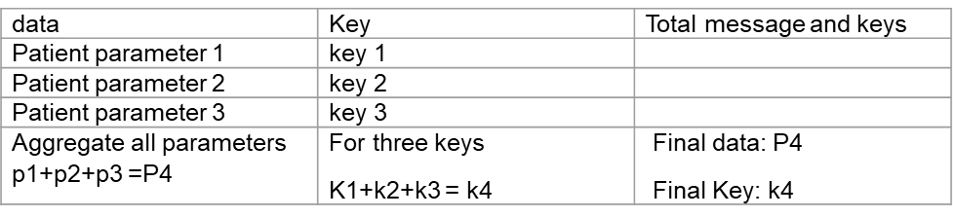
Problem Illustration
The existing method used which is time taking and for data aggregation data is added into single message which is not easy to decrypt and shows data as different parameters

Slide 5
Proposed Method
To overcome the challenge of data aggregation and data security, we introduce the fog-based frame into healthcare systems along with time access control.
In a fog-based frame, fog nodes are widely distributed near data terminals, collect data directly from terminals, and preprocess the data before reporting to the server, thereby greatly reducing the burden on the server.
As for the second challenge, the difficulty lies in guaranteeing both data availability and privacy in data collection.
In this project, when we discuss data availability and privacy, encrypting patients’ data separately aggregating keys in a single request and responding to the user to get all keys in a single request encrypt data using the AES algorithm and provide time-based access to restrict user download based on patient interest

Slide 6
Proposed Method
1.let an patient be 'p' after registering and login into the web page the paitent should fill the file f in a particular time 'T'.
2.file f contains parameters such as
-heart rate 'hr'
-blood pressure 'bp'
-body temperature 'bt'
-body weight 'bw'
3.Then this file is upload to server
before uploading the file, the file is encrypted using a secret key 'sk'
that is each parameter is encrypted with its separate keys generated like
-heart rate 'hr' is encrypted using a key 'hrk' which generates an cipher text 'hrct'
-blood pressure 'bp' is encrypted using a key 'bpk' which generates an cipher text 'bpct'
-body temperature 'bt' is encrypted using a key 'btk' which generates an cipher text 'btct'
-body weight 'bw' is encrypted using a key 'bwk' which generates an cipher text 'bwct'

Slide 7
Proposed Method
4. This encrypted file generates a cipher text file 'ctf’
5. this file 'ctf’ is sent to fog framework
6. On user request for accessing the file the fog framework will aggregate the keys and generate a single key
-that is aggregated key 'agk' that is agk=hrk+bpk+btk+bwk
7. time taken for
- fog framework -t1(all parameters are send to user at one time t1)
- Cloud framework –t1,t2,t3(each parameter has each time of sending each key)
8. Output
The download time of the key sent to the user on request is
fog server-single key all data is sent to the user at once that is agk
cloud-final calculated time is t1,t2,t3=final count

Slide 8
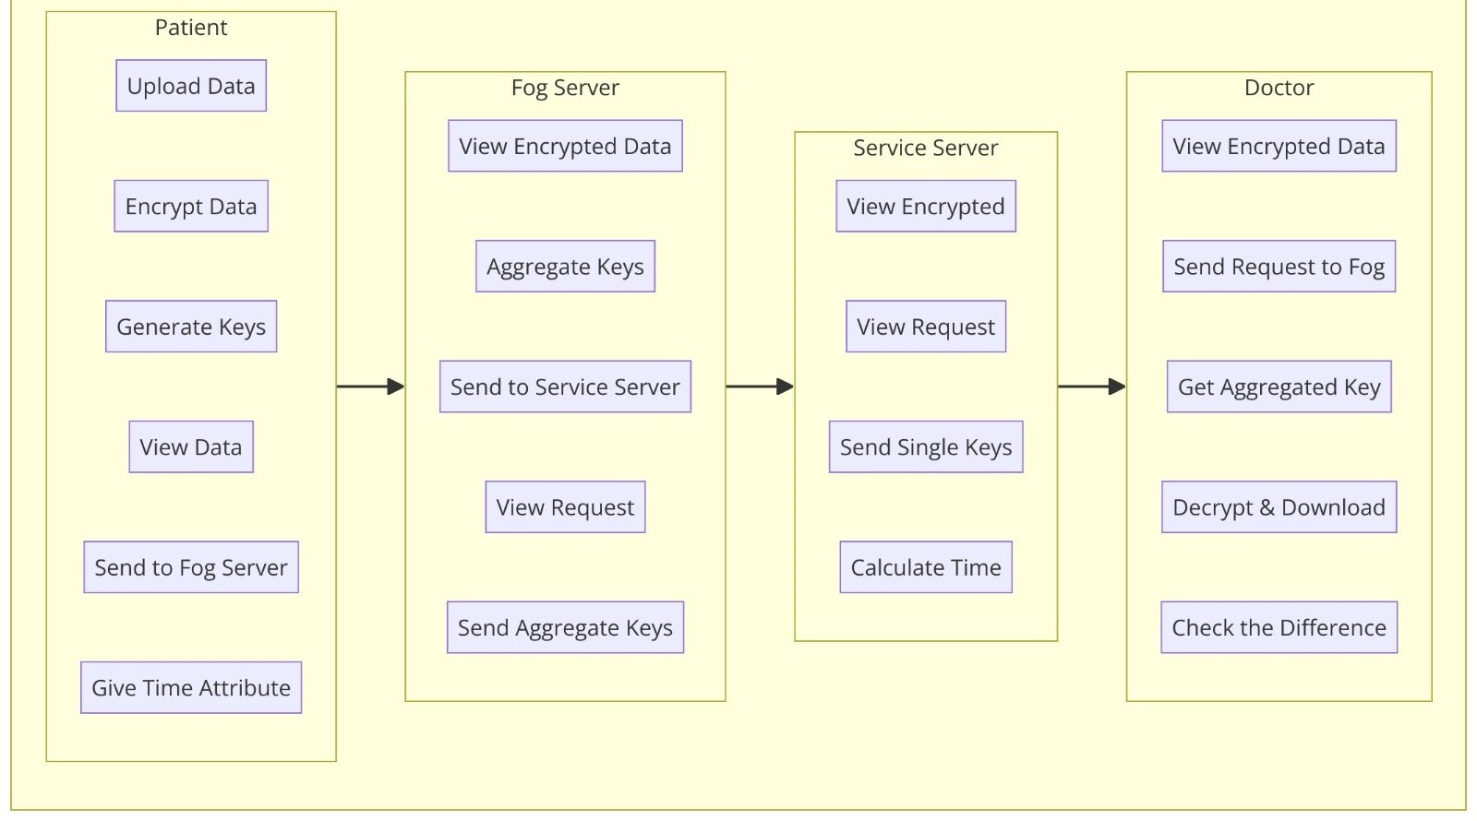
Proposed Method

Slide 9
Experiment Environment
Software Requirements:
Coding Language - Java
Front End - Html, css
IDE - NetBeans
Back End - MySQL

Slide 10
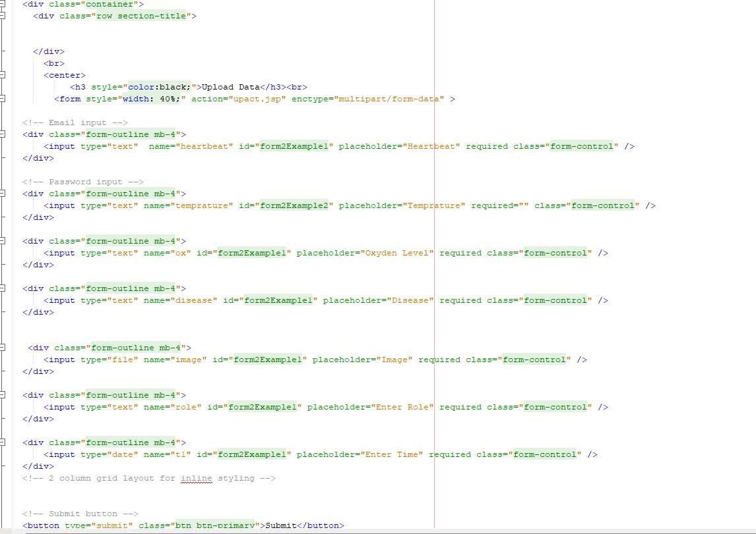
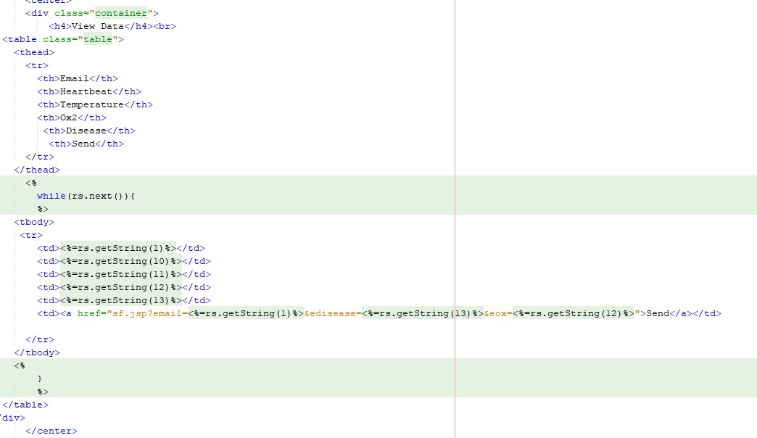
Experiment Screen shots
Patient Upload file
View Encrypted data

Slide 11
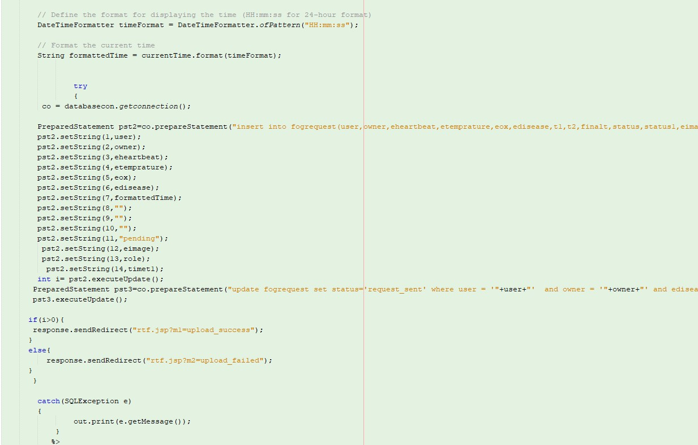
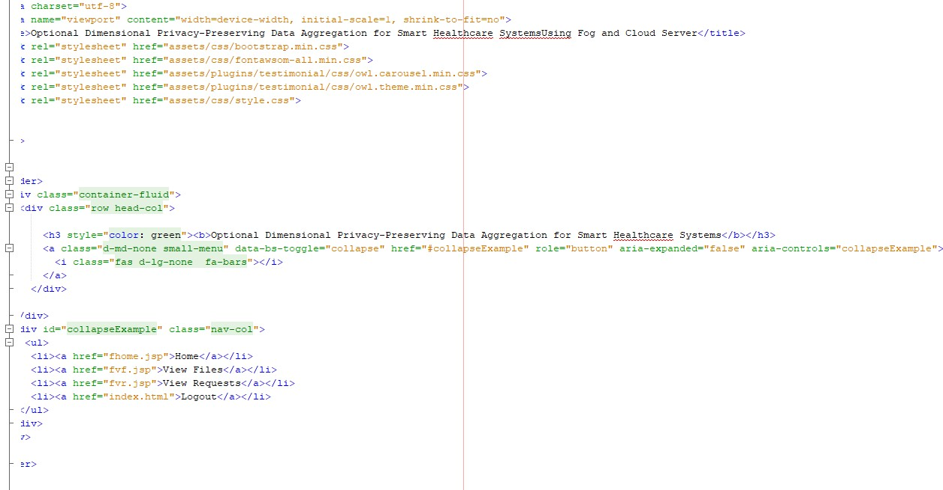
Experiment Screen shots
Request to fog framework
View Request

Slide 12
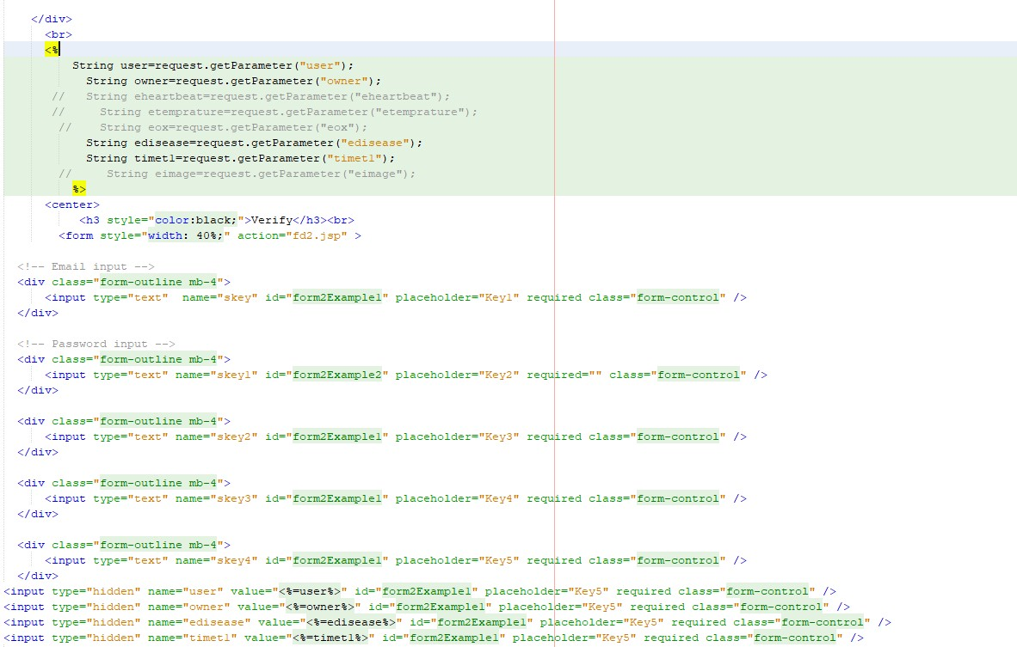
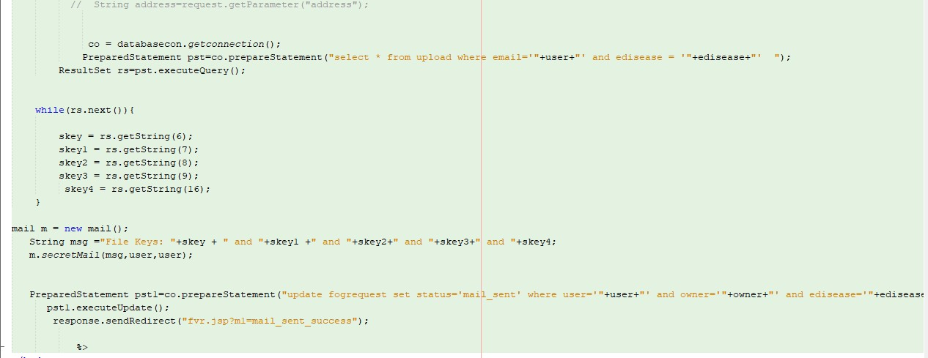
Experiment Screen shots
Download Data
Secret key

Slide 13
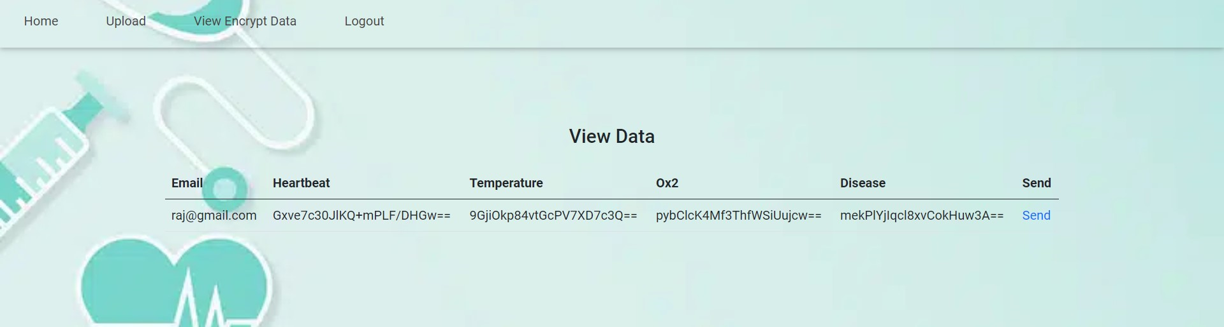
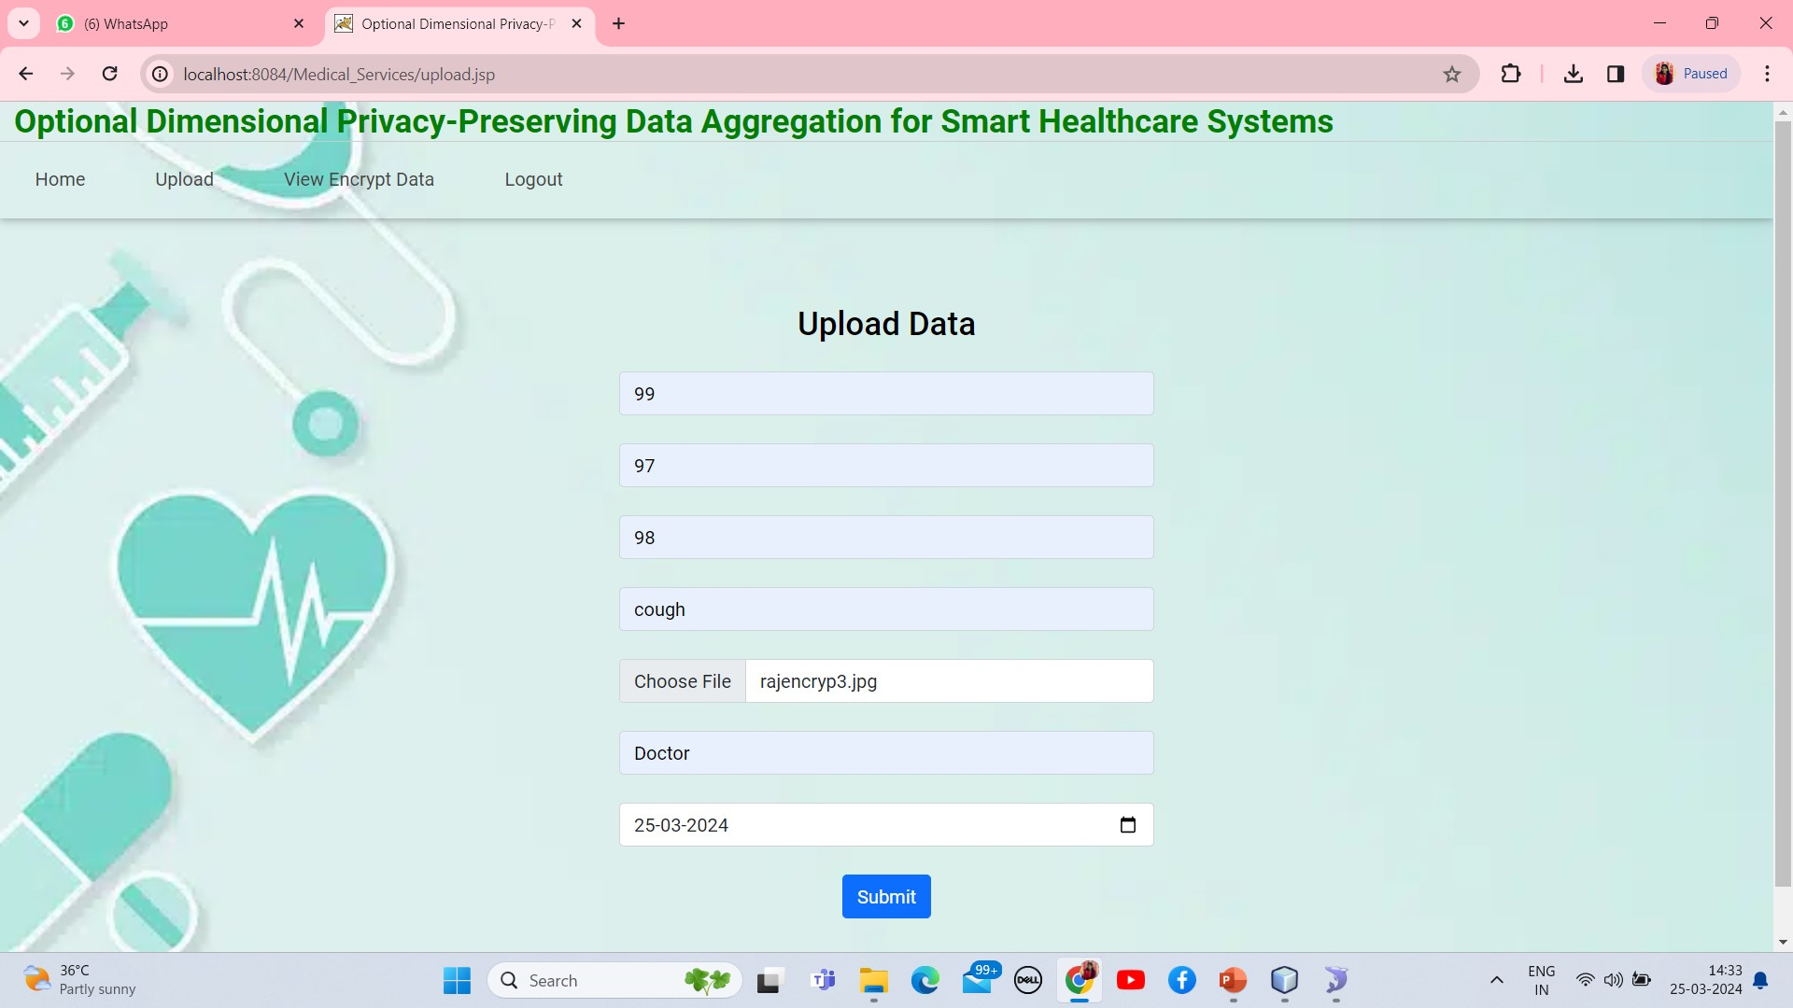
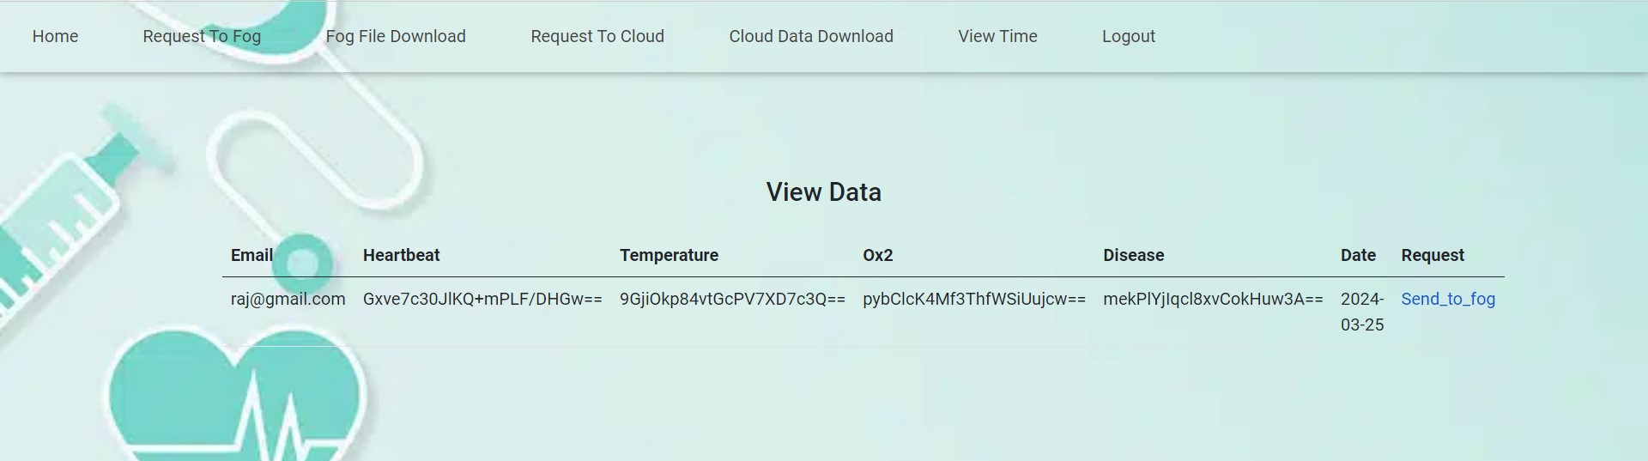
Experiment Results

Slide 14
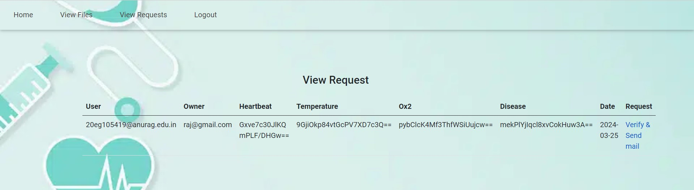
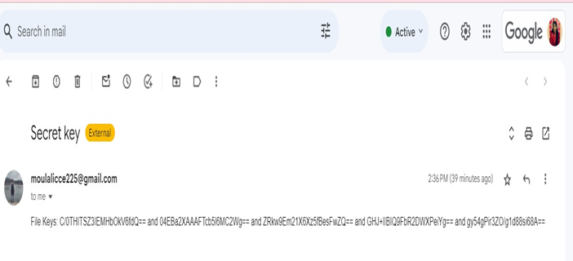
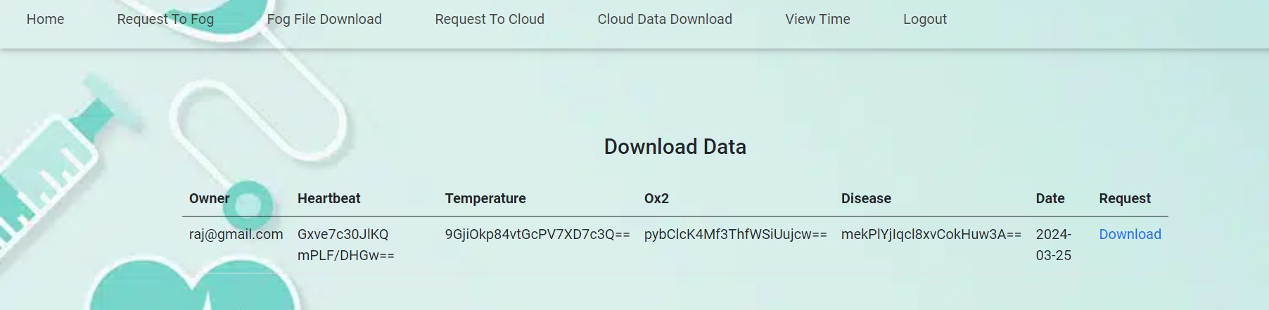
Experiment Results

Slide 15
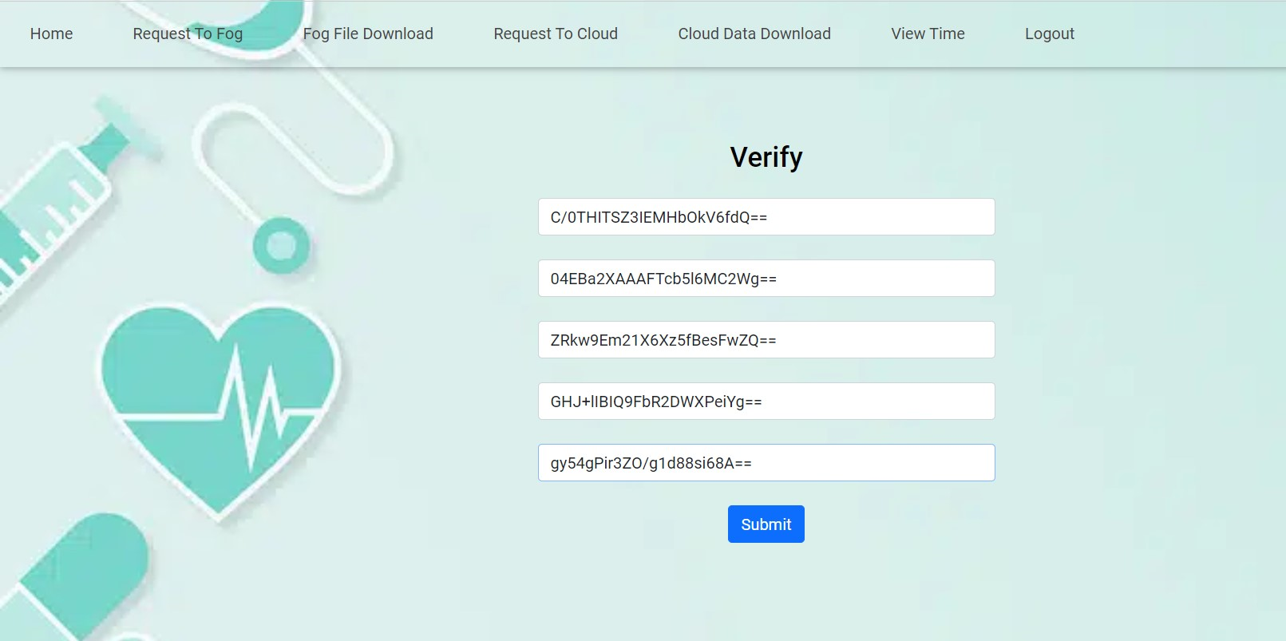
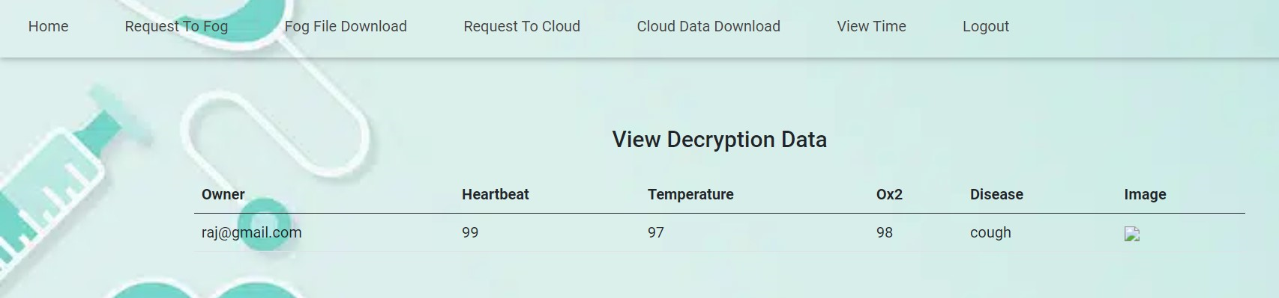
Experiment Results

Slide 16
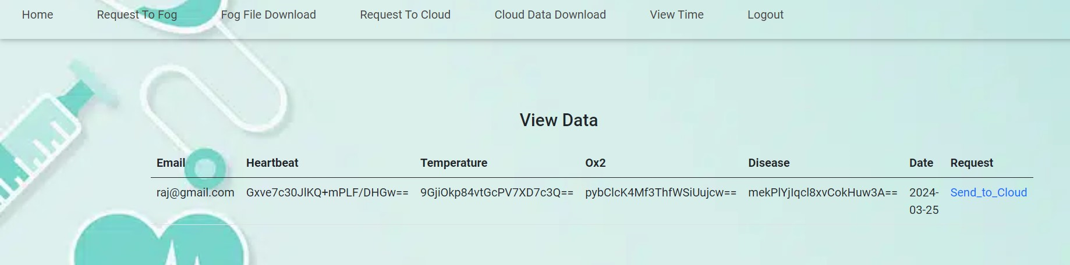
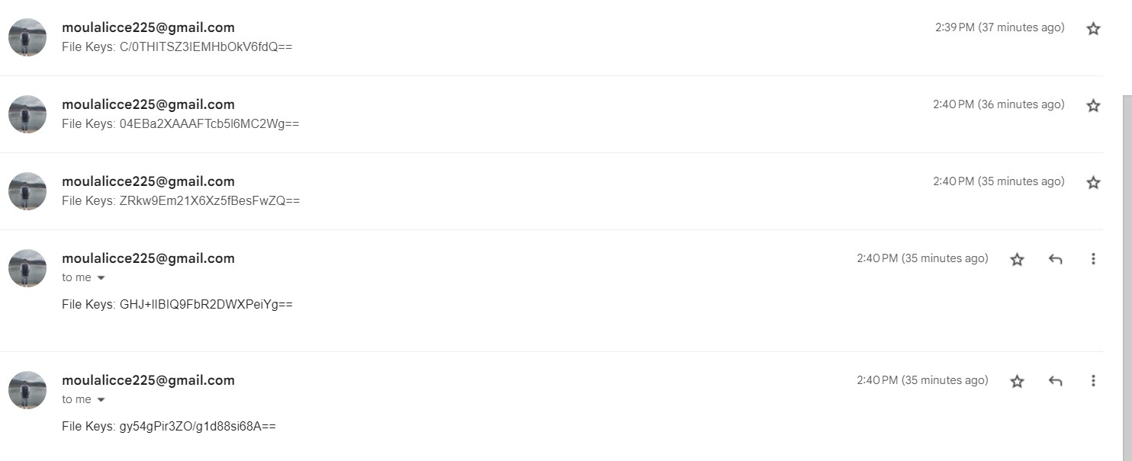
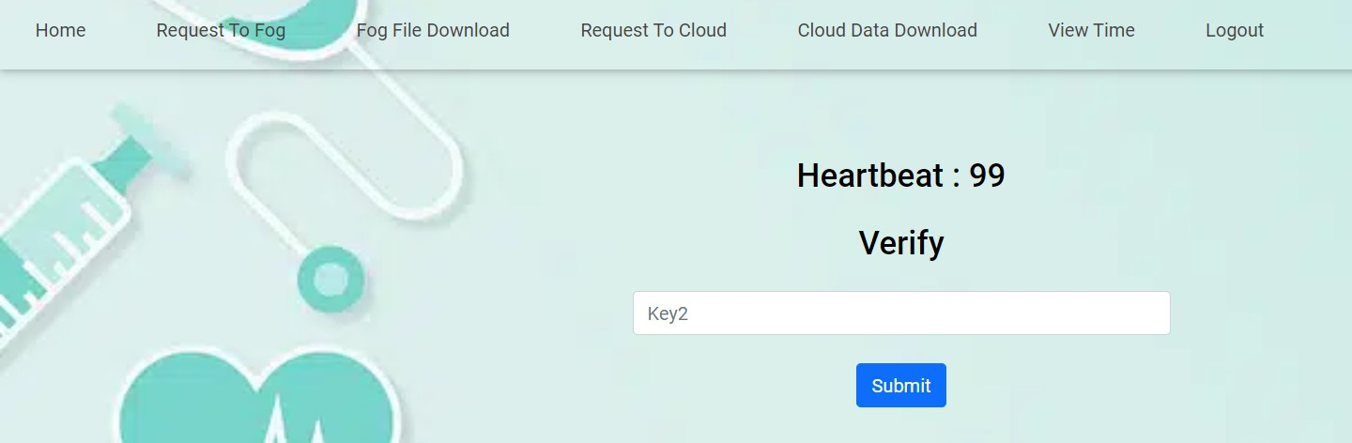
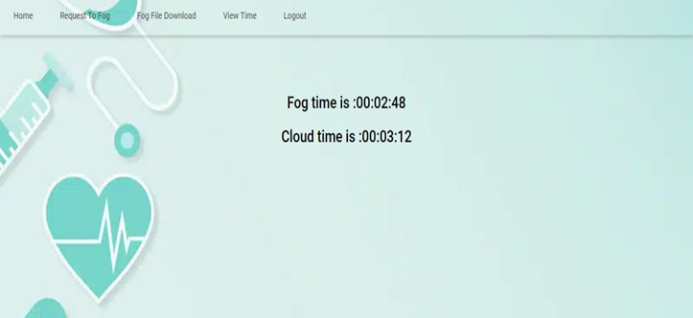
Experiment Results

Slide 17
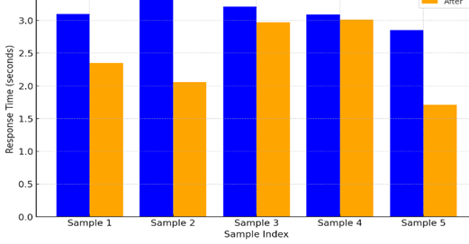
Finding
The proposed method consistently shows significantly faster key transmission times across all five measured instances. This suggests the proposed method could greatly enhance the efficiency of cryptographic processes.
Input | Existing Method | Proposed Method
1 | 3.10 seconds | 2.35 seconds
2 | 3.43 seconds | 2.06 seconds
3 | 3.21 seconds | 2.97 seconds
4 | 3.09 seconds | 3.01 seconds
5 | 2.85 seconds | 1.71 seconds

Slide 18
Finding
The fog-based framework in the proposed method efficiently processes healthcare data at the edge, significantly reducing time.
It incorporates a time-based access control for file retrieval, ensuring data is secure yet accessible within prescribed time limits.
While the fog framework's time to send keys is less than cloud-based alternatives.

Slide 19
Justification
Parameters
Time attribute access control: This model uses time to decide if a user can access a resource by checking conditions based on the user, the resource, and the situation. Labels rank the importance, busyness, or urgency (called priority, congestion, and criticality) which change over time and situations. Access is granted based on these dynamically changing labels, reflecting the current state of users, resources, and environmental conditions. Justification this method is is not used in previous methods
Total Process Time:
Ttotal​=Tprocessing​+Temails​ending​+Temaild​elivery​ Temailsending: Time taken by the email server to send the email.
Temaildelivery: Time until the email is received (this can vary greatly).
Tprocessing: Time the server takes to process the request, including generating keys and preparing the email.
Fog framework time:2mins 48seconds
Cloud framework time:3min 12 seconds

Slide 20
Thank You

